Slide 1
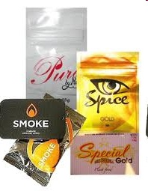

EPIDEMIOLOGICAL FEATURES OF IV DRUG USERS COINFECTED WITH HIV/HCV
Ionut Cristian POPA
infectious diseases specialist
Hospital for Infectious and Tropical Diseases “Dr. Victor Babes”
Bucharest, 30 march 2017

Slide 2
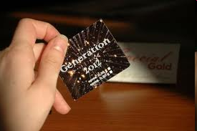
Introduction
IV usage of differents psichoactive substances (heroine and newly ethnobotanicals substances) represent an unpleasent reality in our country
Chronic utilisation of these substances has been related with an significant increase in morbidity and mortality
Various infectious are favorised by the usage of these drugs in improper septic conditions. The most severe ones are bacterial cutaneus infections, right valve endocaditis, staphylococcal bronchopneumonia, HCV hepatitis and HIV

Slide 3
What are illicit “drugs“?
Substances wich are prohibited to commercialize, by their usage (oraly, intranasal or iv) creating a pleasant sensation, but when further repeating their usage leading to “addiction syndrome” – the necessity to repeat the administration and to permanently increas the dosage, in this manner severly affecting the health state and producing behavior changes
Unique user
“Recreational” user
Chronic user with prolonged abstinence intervals
Drug addicted – severe “sevraj syndrome” in the absence of drugs
  Incapacity to control his own life, in permanent need of procuring drugs, antisocial behavior, lack of interest to his own person
  Severe infection associated: bacterial, (cellulitis, bronchopneumonia, endocarditis), HCV, HIV… TB!!!

Slide 4
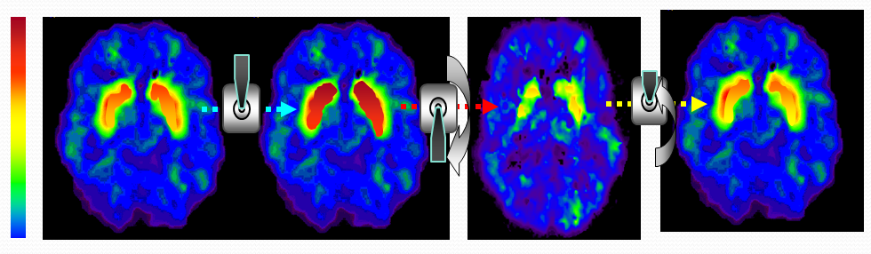
Mechanism – addiction syndrome
Commun mechanism of all “drugs” may be related with the cerebral increasment of neuromediators (dopamine and serotonine) – involved in pleasant cerebral fonctions
Dopaminergic network: reward (motivation), decision capacity, perseverecnce, compulsion, fine movements
Serotonine network: mood, memory, cognitive increasing, sleeping state
Normal
High↑↑↑
Sevraj↓↓↓
After tretment↓

Slide 5
Classification (1)
NARCOTICS / OPIOIDS: heroine, morfine, opium, metadone, codeine, tramadol, phentanyl, buprenorfine, oxicontine
PSICHOSTIMULANT substances: cocaine, amphetamine, (speed), metamphetamine, ecstasy, cofeine?
  = “ethnobotanical drugs” –amphetamine-like effects
HALUCINOGENOUS substances: LSD, mescaline, PCP
CANABINOIDS: marijuana, “weed”, THC, hasis…
  = may have narcotic/psihostimulant or halucinogen effect, depending on dosage and individual tolerance
DEPRESOAR substances: alchohol, diazepam, xanax, - euphoria, relaxation, sedation, sleepnes

Slide 6
Classification (2)
CANABINODS: marijuana, “weed”, THC, hasis…
Overdoze – euphoria, miosis, tahicardia, tahipnea, injected conjunctives, diplopia, dizzines, hipertension, increased apetit, psichosis, sleeping disturbances → treated with diazepam
Sevraj – tremor, nistagmus, inapetence, anxiety, diarrhea, epigastric pain→ treated with clorpromazin
Generarly smoked – low vital risk
Depressor, psichostimulant, halucinogenous effect depending on dosage
NARCOTICS / OPIOIDS: heroine, morfine, opium, metadone, codeine, tramadol, phentanyl, buprenorfine, oxicontine
Overdoze – euforia, miosis, nausea/vomiting, dizarthria, hipoestesia, hipotermia, hipotensiune, respiratory distress, constipation, coma → naloxone
Sevraj – midriasis, rhinorea, sneezing, tears, anxiety, violence, mialgya, sweating, tremor, nausea/vomiting, diarrhea, fever → metadone, codeine, imodium

Slide 7
Classification (3)
PSICHOSTIMULANT SUBSTANCES: cocaine, amphetamine, (speed), metamphetamine, ecstasy, cofeine?
increase reaction speed, energy, lack of hunger
Overdoze : midriasis, muscle contraction, hipertermia, tahiarithmia, hipertension, anxiety, psichosis, delir, inapetence, → haloperidol, betablocker,
Sevraj: somnolence, hunger, psichic instability, paranoid illusion, acute depression / suicidal risk → bromazepan, clonazepam
ETHNOBOTANICAL DRUGS… amphetamine-like
Available in Romania - beginning from 2009-1010
HALUCINOGENOUS: LSD, mescaline, PCP
DEPRESSORS: alchohol, diazepam, xanax, - euphoria, relaxation, sedation, sleepness

Slide 8
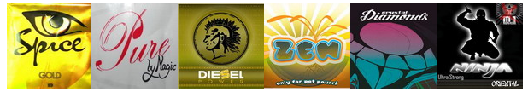
What are“ethnobotanical drugs” ?
Heterogenous cathegory of commercial products
Semisinthetic derivates of amphetamines/cannabinoids impregned with differend herbal products having psichostimulant effects
No existing unique standard chemical formula
Many ex-heroine drug iv users have recently passed on “ethnobotanical drugs” (therefore beleving they have cured them selves from heroine…)
Even if the “official recommandation” made by producers is to be smoked, people have lerned to use them iv, increasing the pleasant effects
Usage of different fluids as solvents… (kitchen water…)
Overdoze : midriasis, areactive pupiles, hipertermia, tahiarithmia, hipertension, inapetence, anxiety, psichosis, delir → haloperidol, betablockers, clonazepam
Sevraj: miosis, hipotermia, hipotension, vomiting, respiratory distress, coma, → naloxone

Slide 9
 | HEROINE | AMPHETAMINE | ETHNOBOTANICALS
overdose | euforia, miosis, nausea, disarthria, hipoesthesy, hipothermia, constipation, respiratory distress, coma | midriasis, hiperthermia, muscle contraction, fever, tahiarithmia, hipertension, anxiety, psichosis, delir, inapetence | midriasis with areactive pupils, tahiarithmia, hiperthermia, hipertension, inapetence, psichosis, delir
 | naloxone | haloperidol, betablockers | haloperidol betablocker
sevraj | midriasis, mialgya, rhinorrea, tears, snooze, anxiety, sweat, tremor, fever, diarheea, violence | somnolence, hunger, psichic instability, paranoide illusions, depression, suicid | miosis, hipothermia, hipotension, vommiting, respiratory distress, coma
 | metadona codeina | bromazepam clonazepam | naloxone

Slide 10
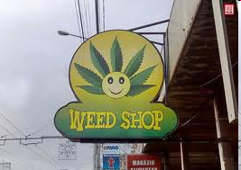
Why are “etnhobotanicals” so dangerous?
“Legal” drugs (?!!)…..
Cheep / accesible drugs (30-40 RON ~10 doses)
Most consummers are social cases
Psichostimulant efect is intense but very short lasting – rapide addiction
Request multiple daily administration
Many users are sharing the same product, often using also the same needle
No coherent programms to inform the youngs about ethnobotanicals…
No coherent legislation…

Slide 11
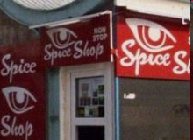
“Legals” complication…
Uninsured patients
Homeless,
No identity paper
No family medicine…
Multiple addiction: drugs / smoke / alchohol
Severe behavior disorders
Drugs traffic…
Rezistence to benzodiasepines, haloperidol…
Refused by many medical services
No available toxicological tests
No standard treatment

Slide 12
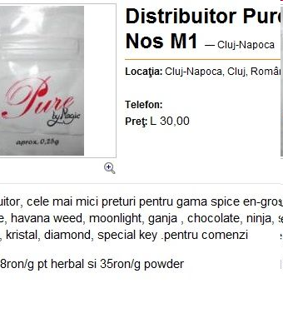
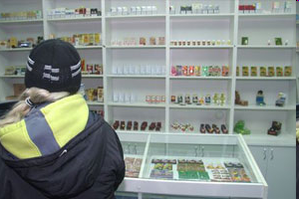
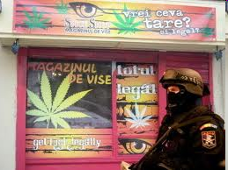
Available in “dream shops” or on the internet
- prohibitted after 2014…
Also commercialised as:
- plants fertilisators
- bath salts

Slide 13
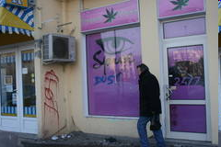
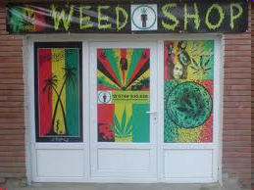
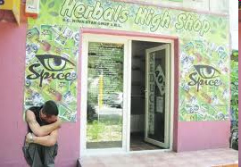
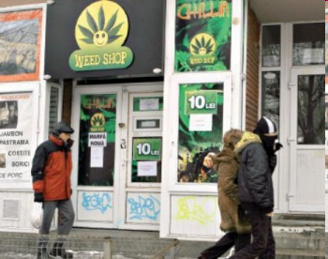

Slide 14
HIV/VHC coinfection – statistics
 | 2007 | 2008 | 2009 | 2010 | 2011 | 2012 | 2013 | 2014 | 2015 | 2016
Heterosexual | 366 (78%) | 423 (76%) | 417 (75%) | 428 (75%) | 468 (60%) | 456 (51%) | 520 (54%) | 529 (59%) | 478 (59%) | 427 (65%)
Homosexual | 20 (4%) | 43 (8%) | 51 (9%) | 66 (11%) | 103 (13%) | 98 (11%) | 98 (10%) | 137 (15%) | 123 (15%) | 116 (18%)
IV drugs | 6 (1%) | 4 (1%) | 12 (2%) | 18 (3%) | 158 (20%) | 283 (31%) | 296 (31%) | 190 (21%) | 163 (20%) | 100 (15%)
Materno-fetal | 9 (2%) | 13 (2%) | 23 (4%) | 27 (5%) | 22 (3%) | 21 (3%) | 28 (3%) | 17 (2%) | 20 (2%) | 4 (1%)
Unknown | 69 (15%) | 72 (13%) | 50 (9%) | 32 (6%) | 29 (4%) | 41 (5%) | 16 (2%) | 20 (2%) | 23 (3%) | 7 (1%)
TOTAL | 470 | 555 | 553 | 571 | 780 | 898 | 958 | 893 | 807 | 654
Source: INBI “Matei-Bals ”www.cnlas.ro - 31 dec 2016
~12.000 iv drugs consummers in Bucharest area (ARAS 2015)
~90% of IVDU have also HVC antibodies
30-40% IVDU tested positives for HIV
10-15% of IVDU have also HVB
~33% of IVDU in our hospitaldatabesa also have TB with differend localisation
We are seeing increasing more resistent TB strains, MDR multidrogresistent, XDR…
= major risk for TB dissemination in the general population…

Slide 15
Harm-reduction strategy…
Substitution therapy with Metadone
not recommended for “ethnobotanical drugs”…
Exchange syringes programme
temporary stopped after 2010, achisition related troubles
Psichological counselling...
Admission in toxicological units...
First-aid kit, training programes for IVDU
“Consummer rooms” – allow the iv drug usage in an controlled environment, with minimal medical assistence, offer rapid testing for HIV/HVC, syringes, social support, protect identity
Cannot be implemented in according with Romanian legislation
Public oppinion ?!

Slide 16
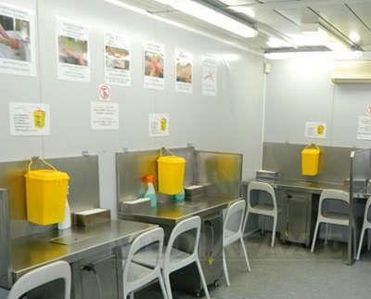
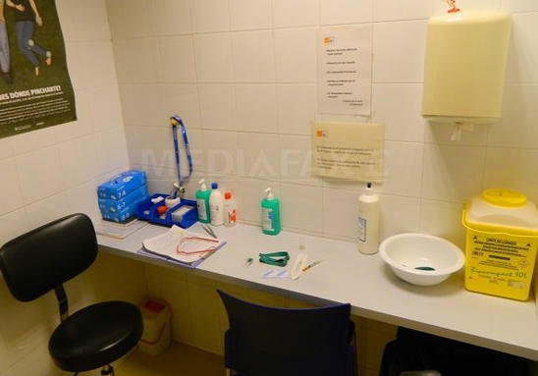
Harm-reduction strategy…
“Consummer rooms” – allow the iv drug usage in an controlled environment, with minimal medical assistence, offer rapid testing for HIV/HVC, syringes, social support, protect identity
Cannot be implemented in according with Romanian legislation
Public oppinion ?!
Spain, Switzerland, Norway, Germany, Netherland, France, Danmark, Canada, Australia

Slide 17
Conclusions
IV drug usage represent a major social and public health problem in Romania, predominantly affecting the younger generation in larges urban areas
This may interest all social cathegories of peoples but the vulnerable groups with low economical status are at particularly high risk
Mortality and morbidity is high, determinated by differend bacterial infectons, (celullitis-bronchopneumonia-endocarditis-sepsis), HIV, VHC, VHB/VHD, and tuberculosis
Lack of legislation and poorer medical services ofert to the IVDU patients will further increase the risk for dissemination of HIV/HCV, TB infection into the general population.

Slide 18
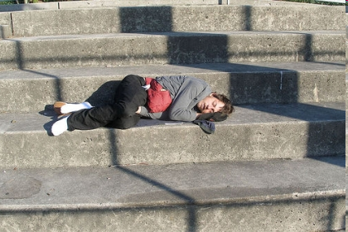

Thanck you!

